Slide 1
Relation in Hibernate

Slide 2
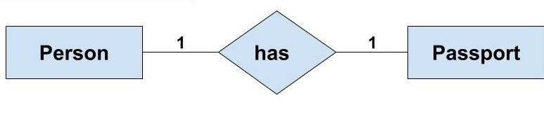
One To One
To do one to one realtion
creat two class and one of class has object of other class
And add One to One (cascade=CascadeType.All)
If you want name fK add JoinColumn(name = "")
And add setter and getter with all data

Slide 3
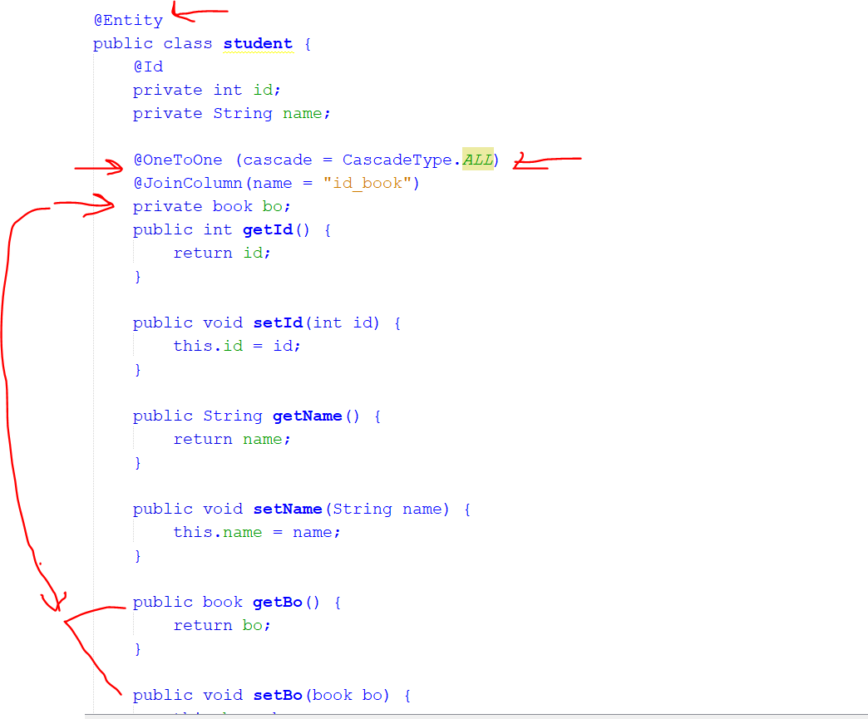
In code pakage Realtionshio :onetoone
Class name student and other book
Student class is

Slide 4
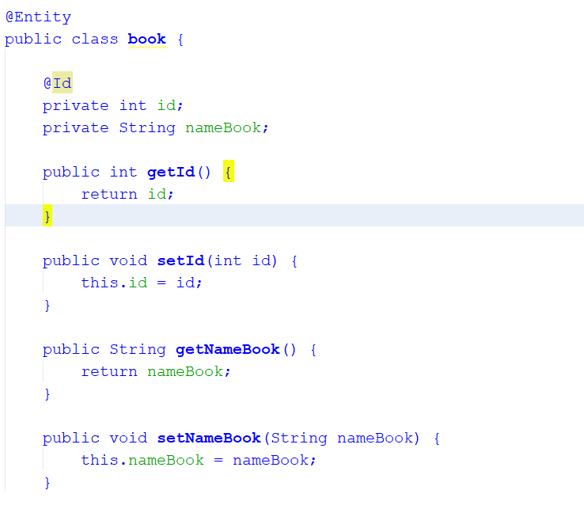
Book class

Slide 5
note
If not put cascade then when save and do operation on class the other class not do this operation
Join coulm aim to name the pk in class in data base

Slide 6
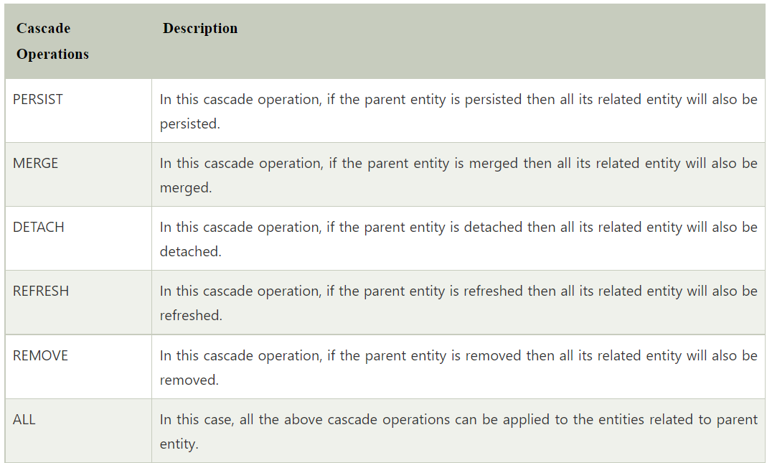

Slide 7
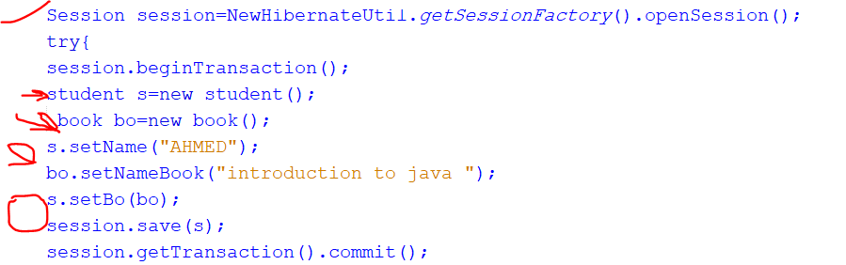
operation IN ONE TO ONE
1- INSET
Creat object and assign vaule then creat anthor abject and assign vaule
Assign second object in frist object and save first object in session code is :

Slide 8
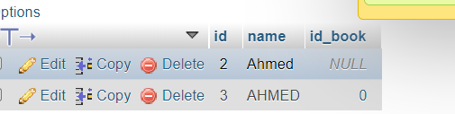

When do insert

Slide 9
select
Use session.get (Classname.Class,id of object)
student s = new student();
s.setId(5) ; //must with id of obidect
student res = (student) session.get(student.class, s.getId());
System.out.println("Name is " + res.getName());
System.out.println("BOok is " + res.getBo().getNameBook());

Slide 10
Delete=sarch +delete
student s = new student();
s.setId(id);
student res = (student) session.get(student.class, s.getId());
session.delete(res);

Slide 11
Updata=select+new assign vaule
session.beginTransaction();
student s = new student();
s.setId(id);
student res = (student) session.get(student.class, s.getId());
res.setName("haba");
res.getBo().setNameBook("data analysis ");

Slide 12

How do if any act with class anthor affect
with creat object and add anotion
one to one and cascase.All and mappedBy =“name of object in other class”;

